Slide 1

AUTOMATION TESTING
SELENIUM

Slide 2
HOW TO UPLOAD FILE USING AUTOIT
AutoIt v3 is a freeware BASIC-like scripting language designed for automating the Windows GUI and general scripting.
It uses a combination of simulated keystrokes, mouse movement and window/control manipulation in order to automate tasks in a way not possible or reliable with other languages (e.g. VBScript and SendKeys).
AutoIt is also very small, self-contained and will run on all versions of Windows out-of-the-box with no annoying “runtimes” required!

Slide 3
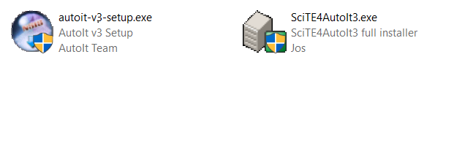
DOWNLOAD AND INSTALLATION
https://www.autoitscript.com/

Slide 4
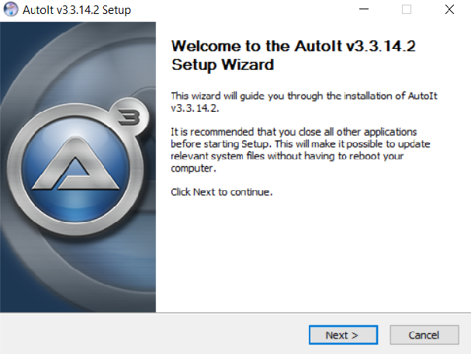
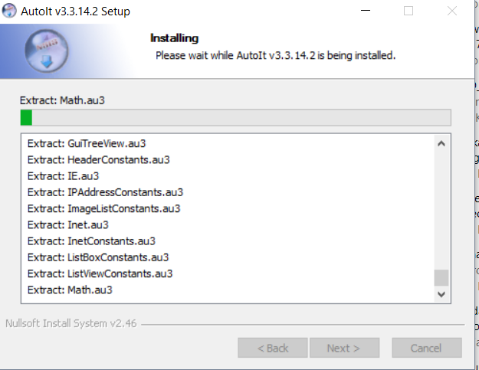
AUTOIT V3

Slide 5
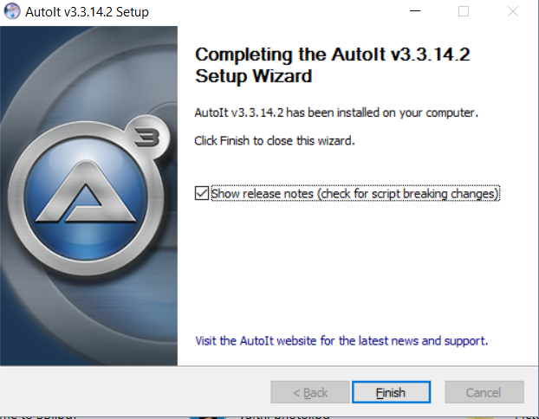
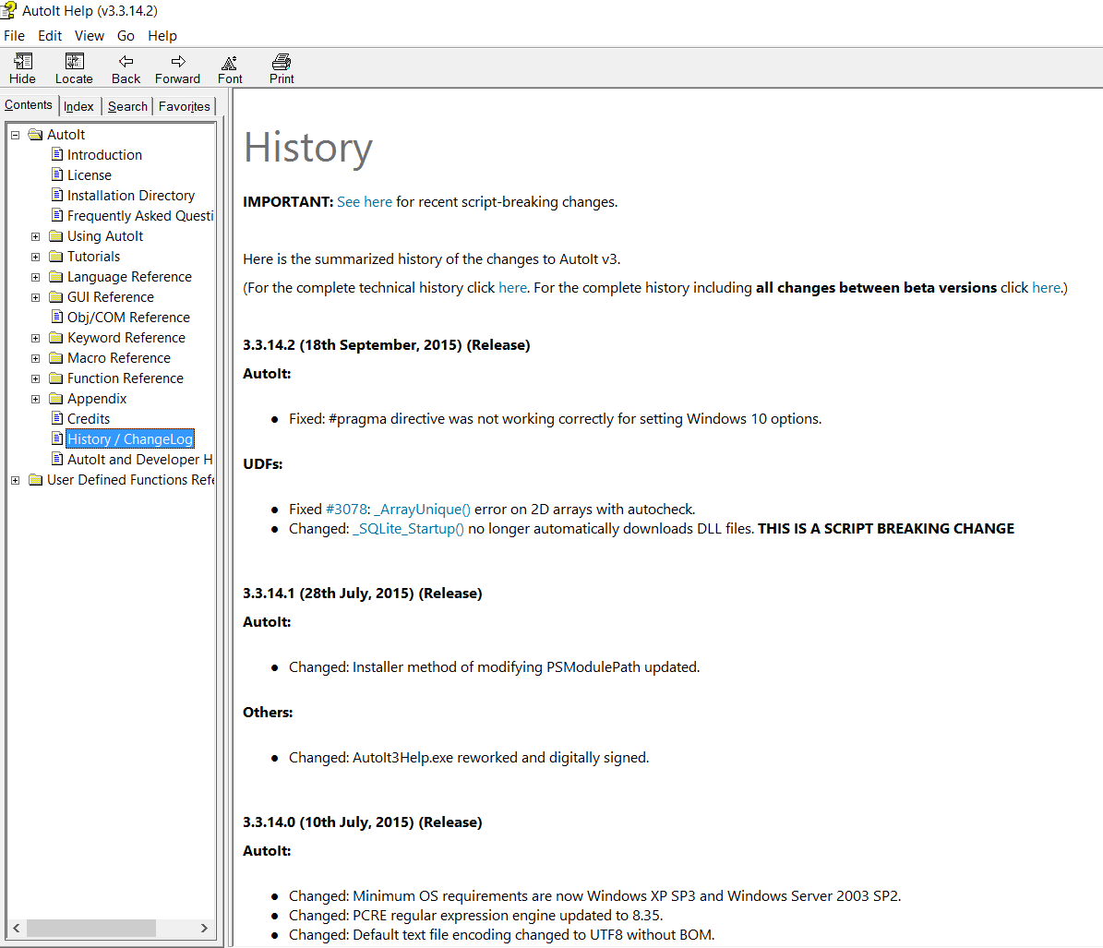

Slide 6
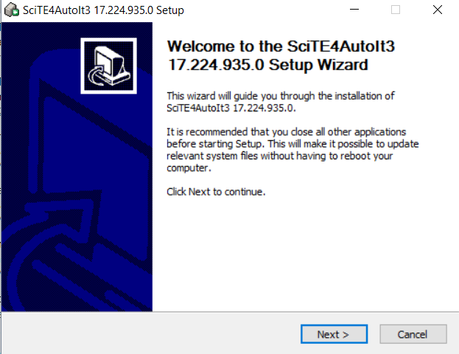
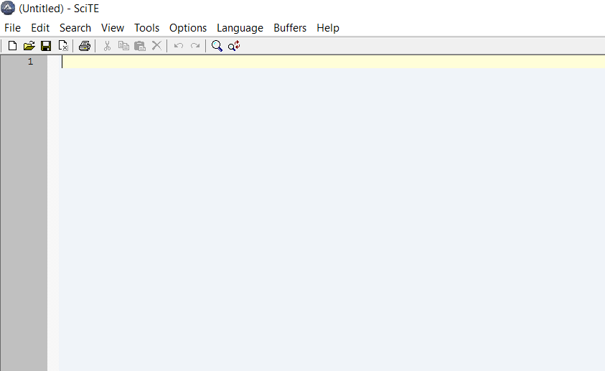
AUTOIT EDITOR

Slide 7
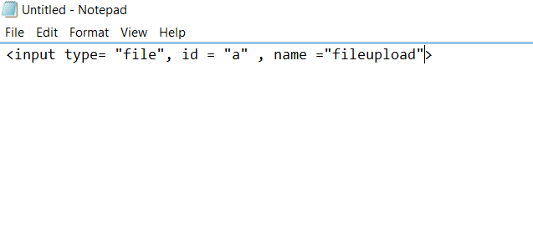
CREATING HTML FILE

Slide 8
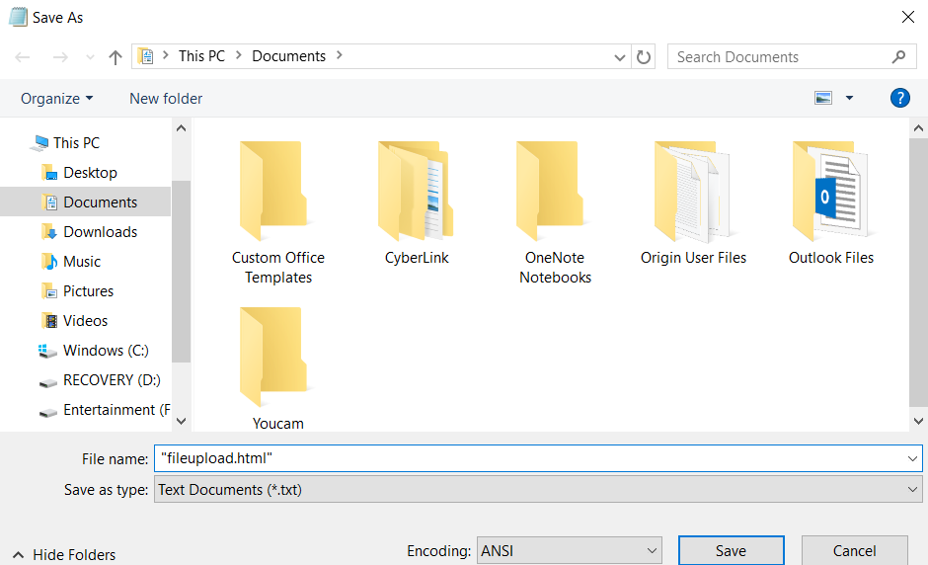

Slide 9
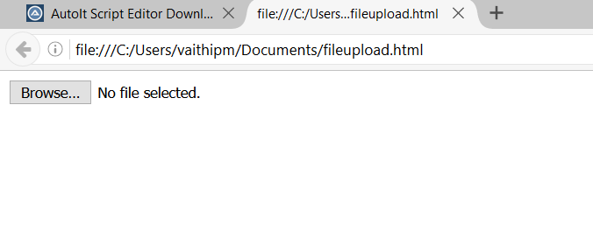

Slide 10
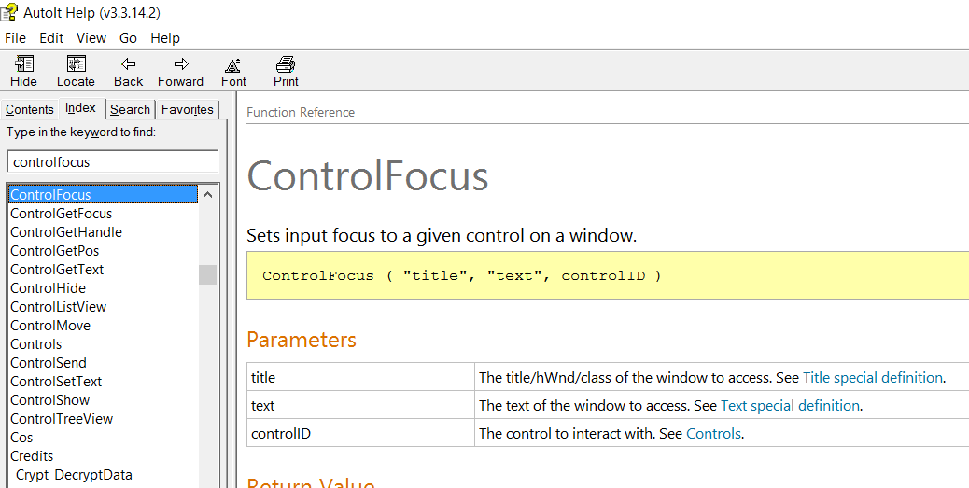
COMMANDS

Slide 11
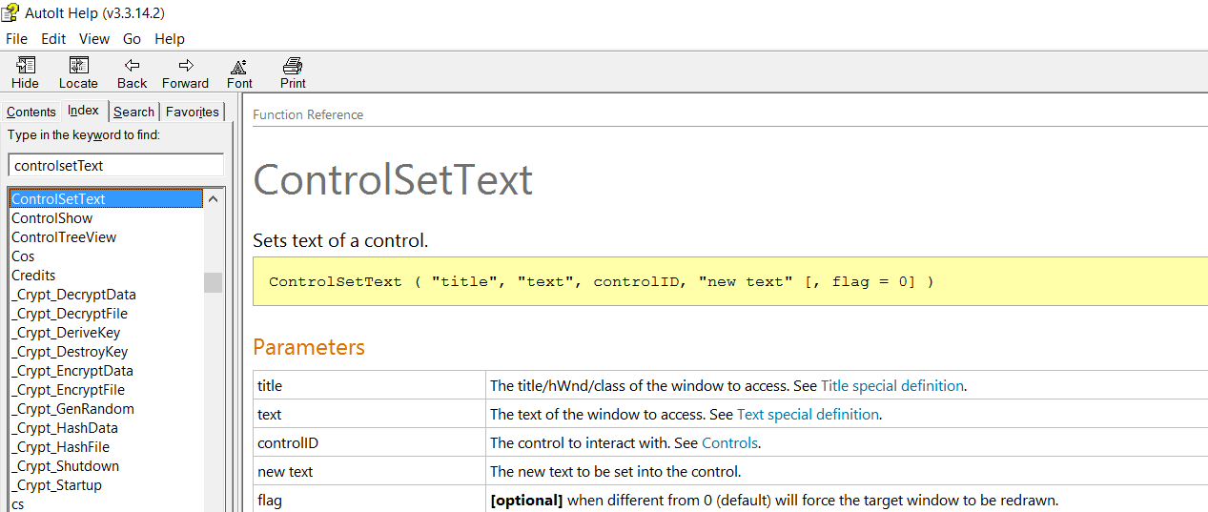

Slide 12
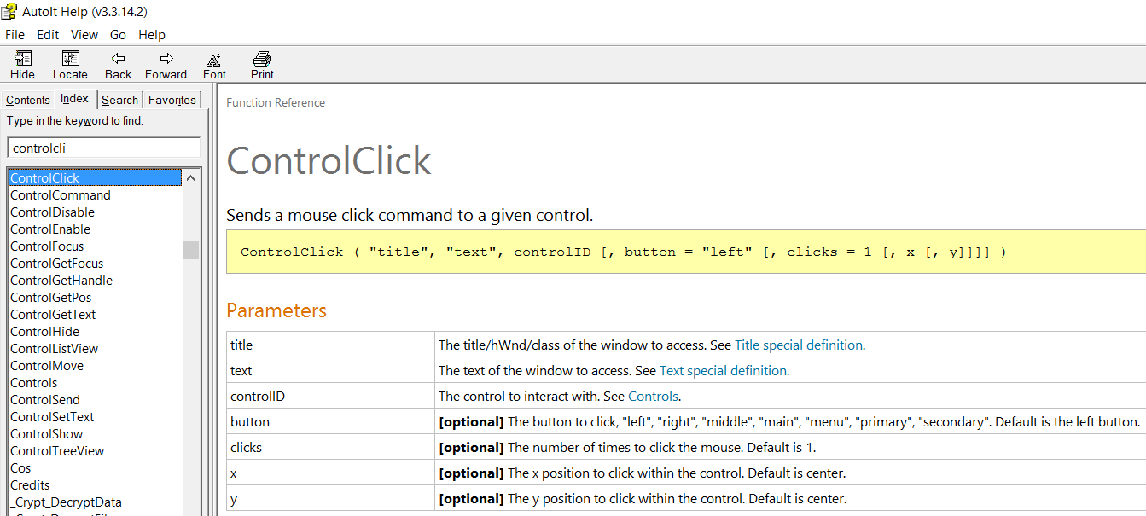

Slide 13
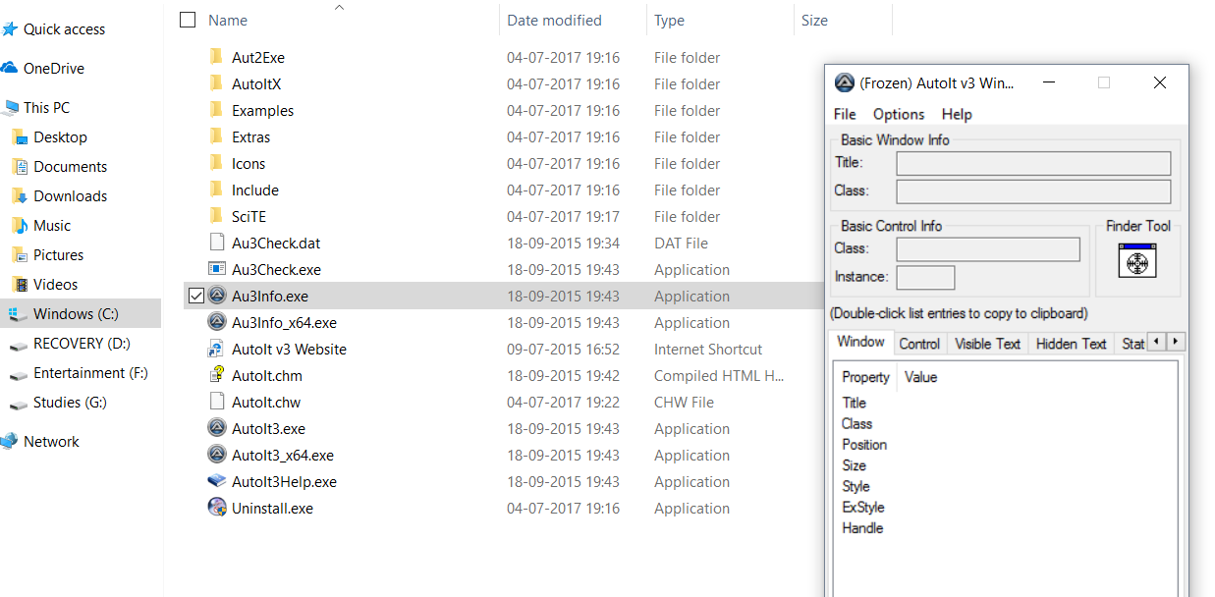
LOCATING OBJECTS

Slide 14
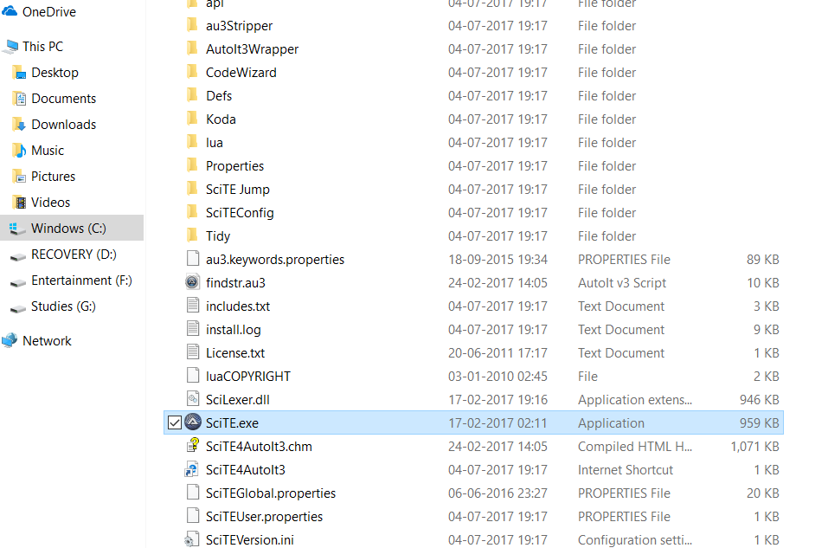

Slide 15
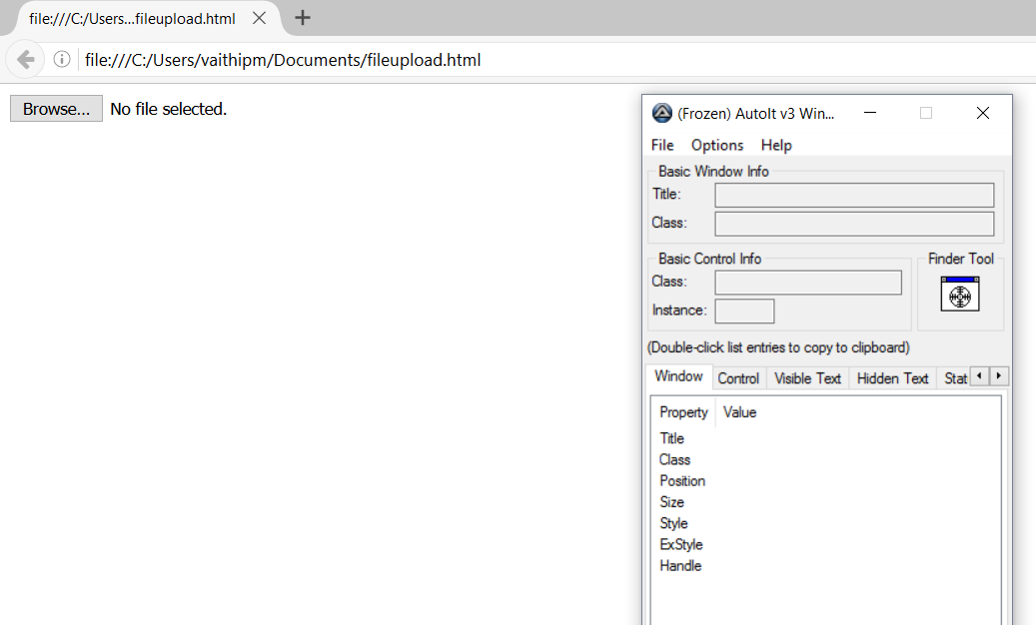

Slide 16
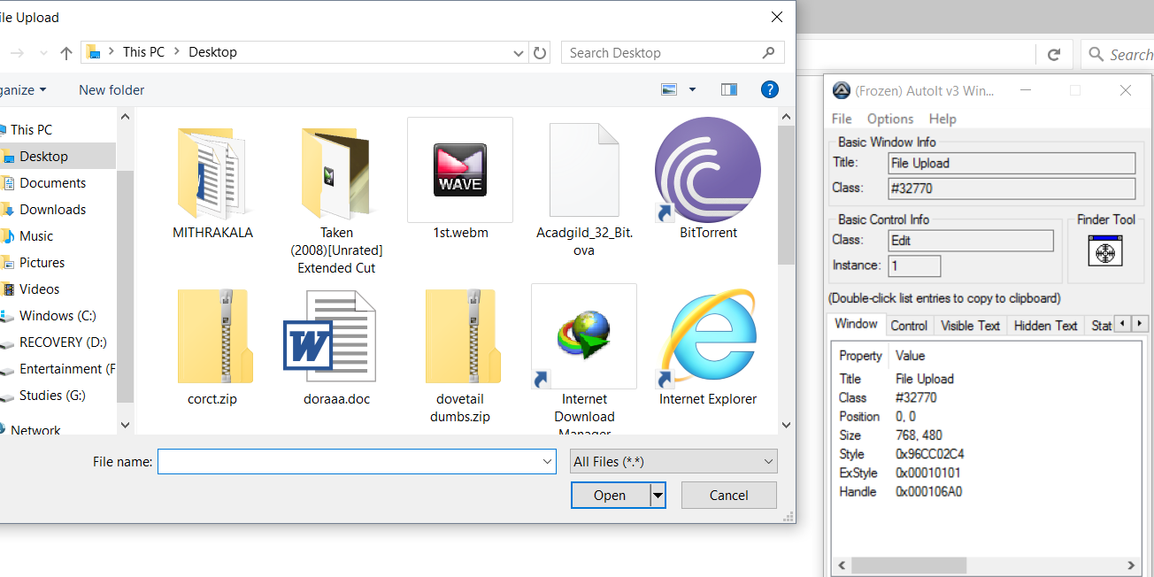

Slide 17
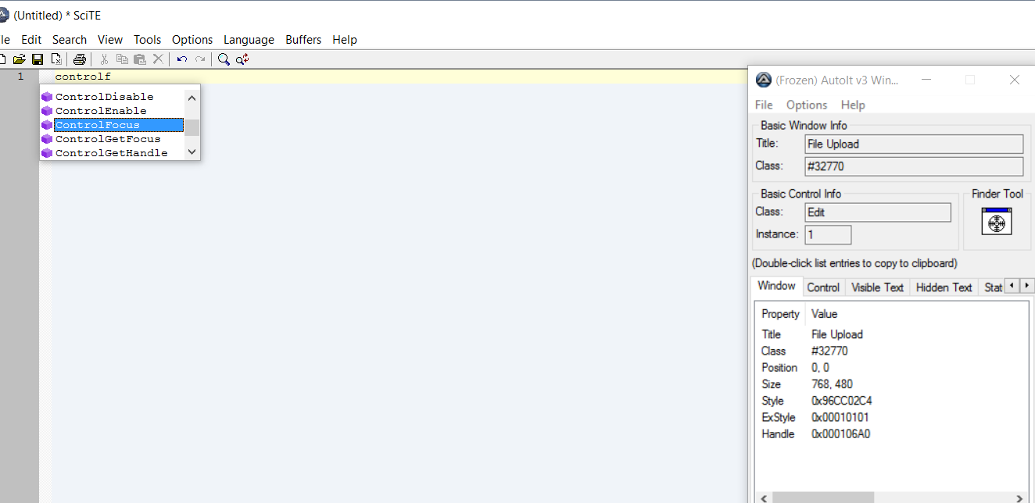

Slide 18
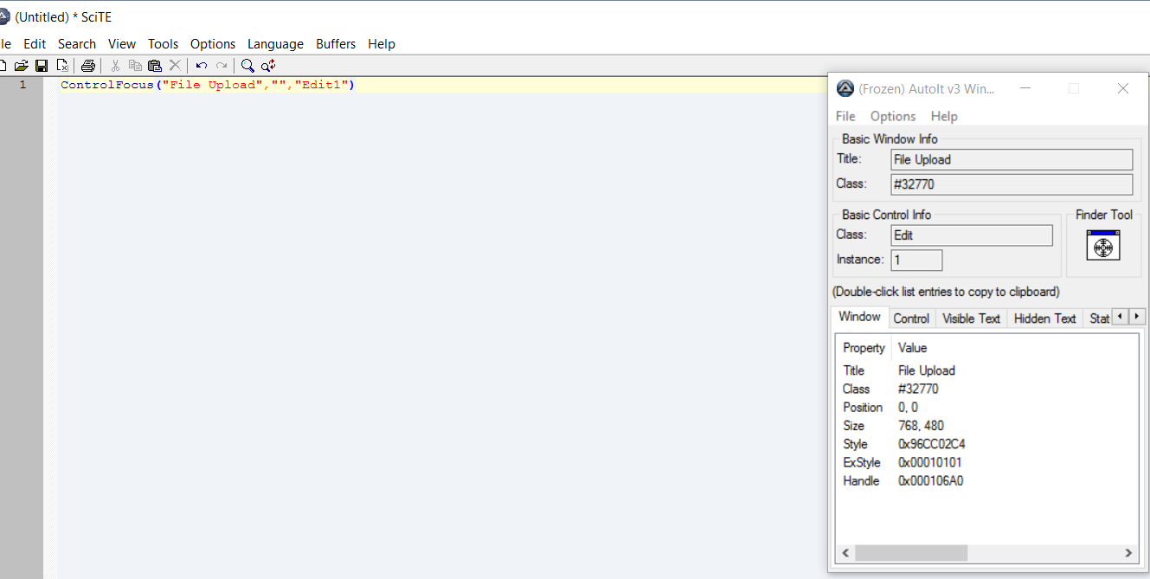

Slide 19
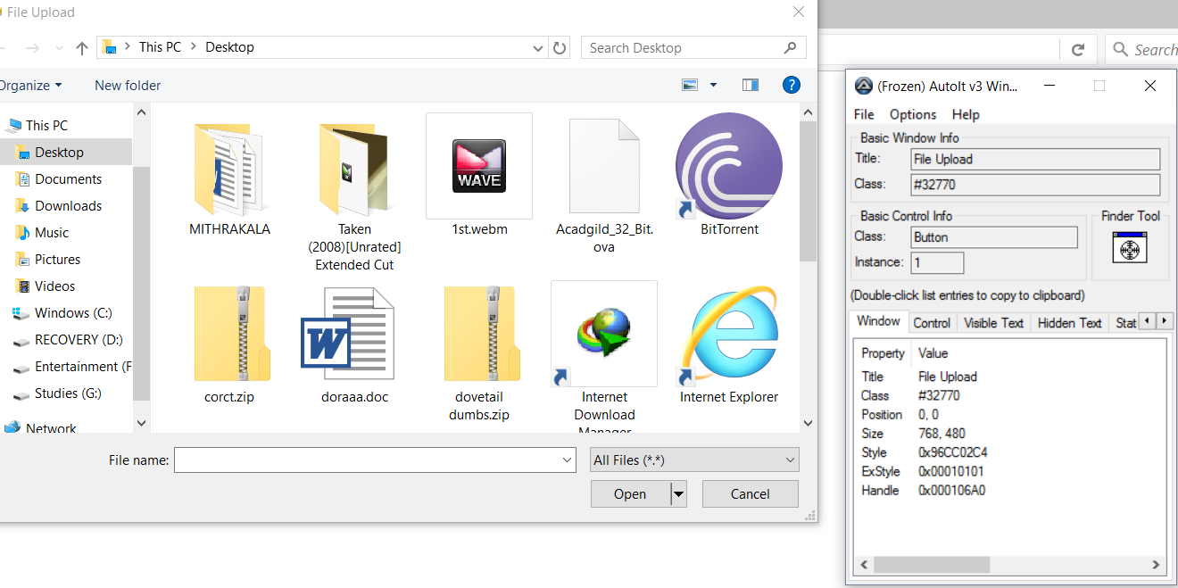

Slide 20
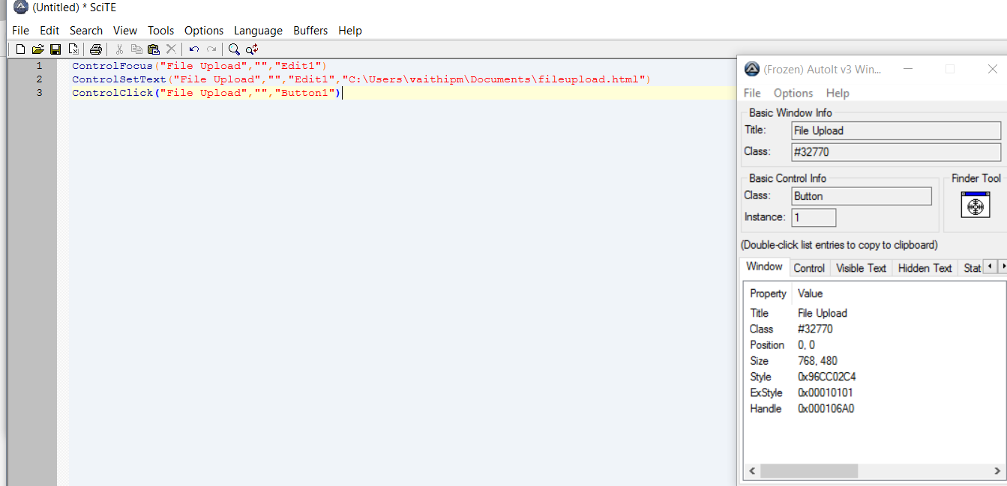

Slide 21
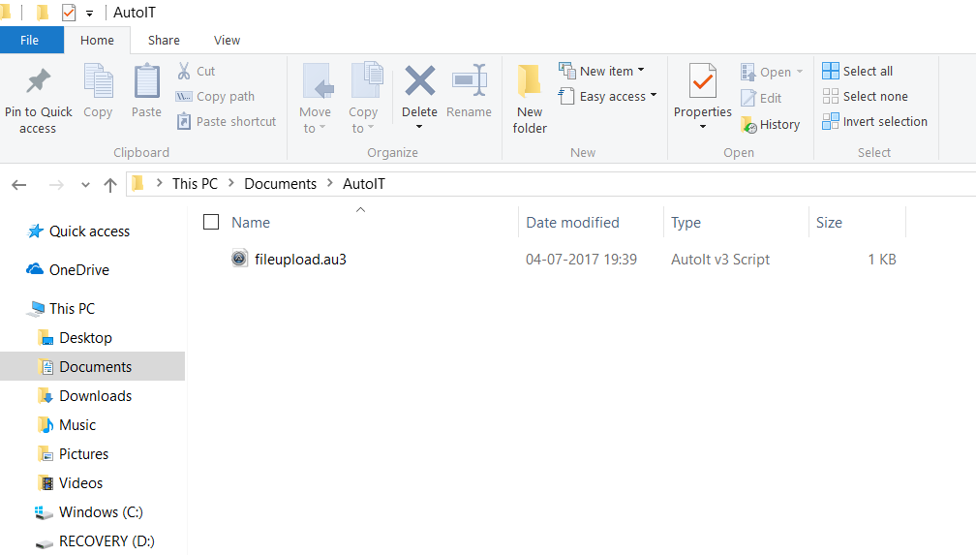
COMPILATION

Slide 22
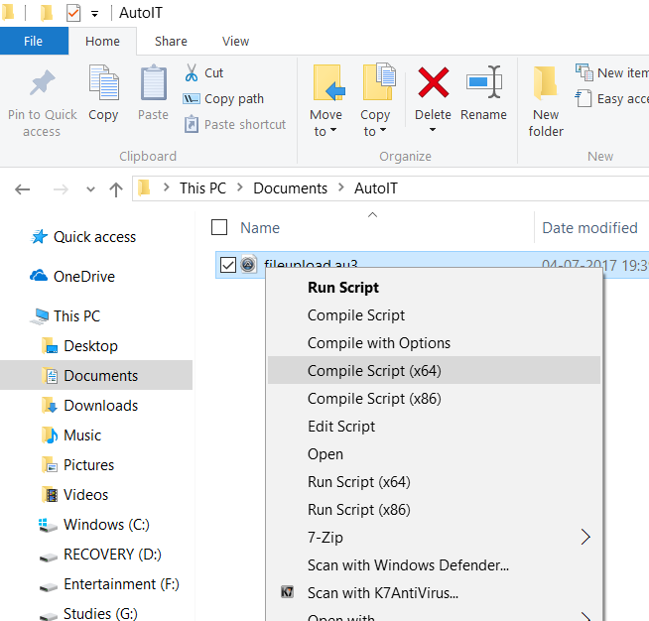

Slide 23
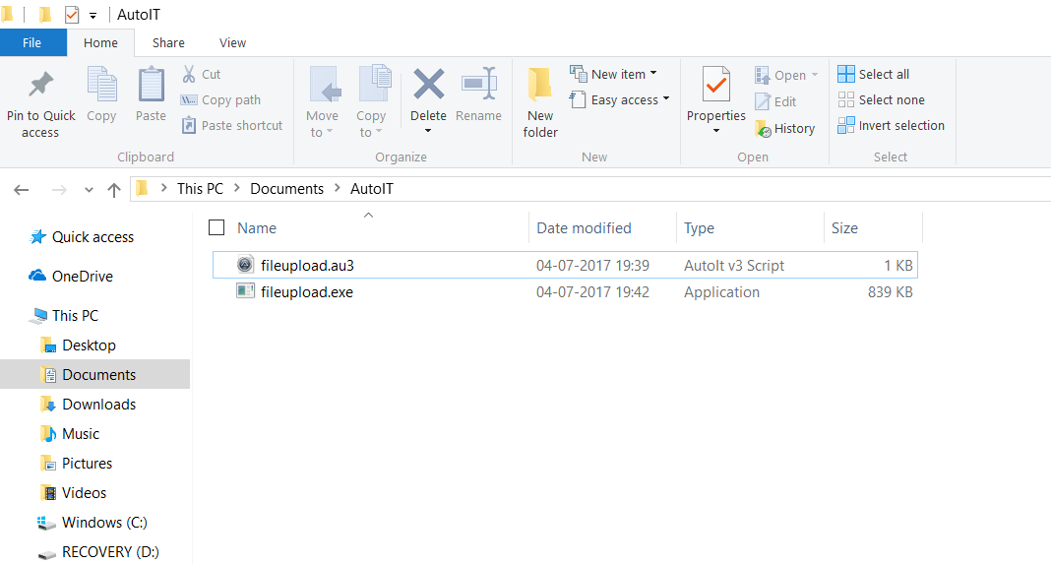
EXECUTION

Slide 24
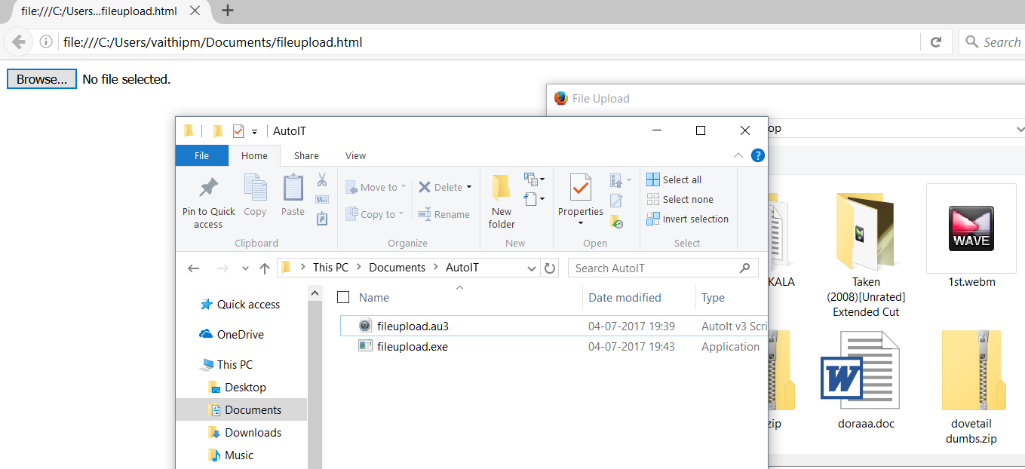

Slide 25
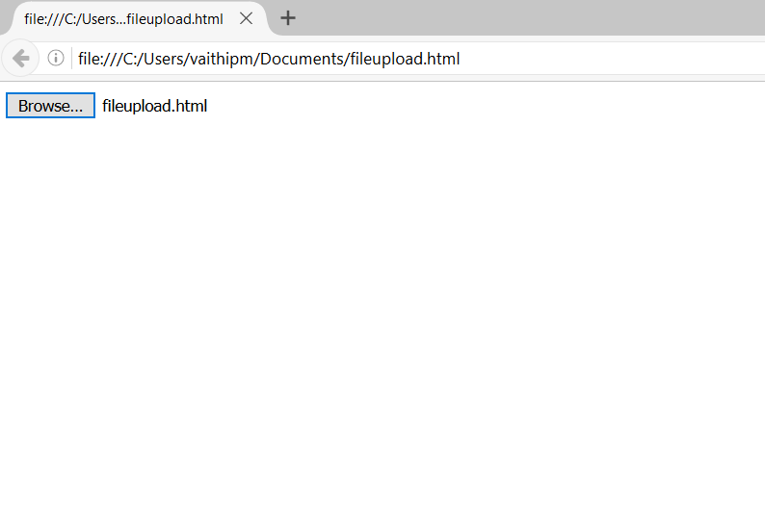

Slide 26
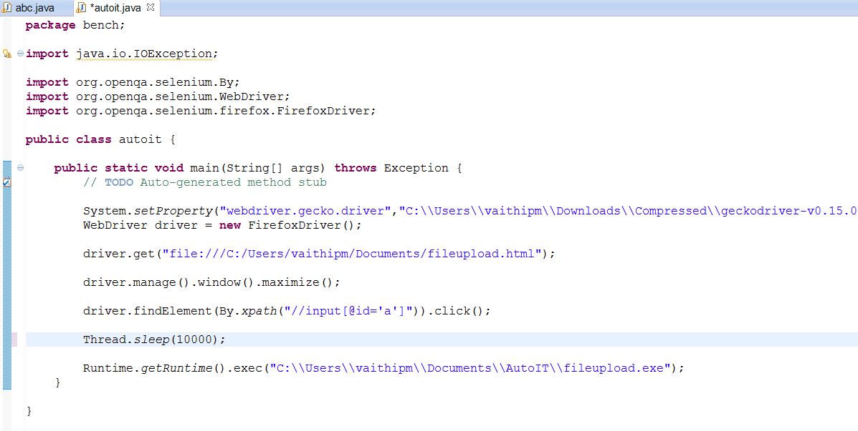
INTEGRATION WITH SELENIUM

Slide 27
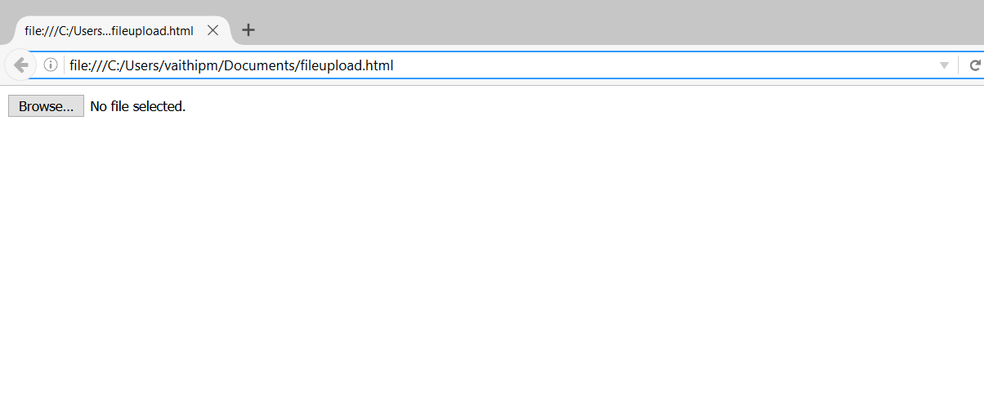

Slide 28
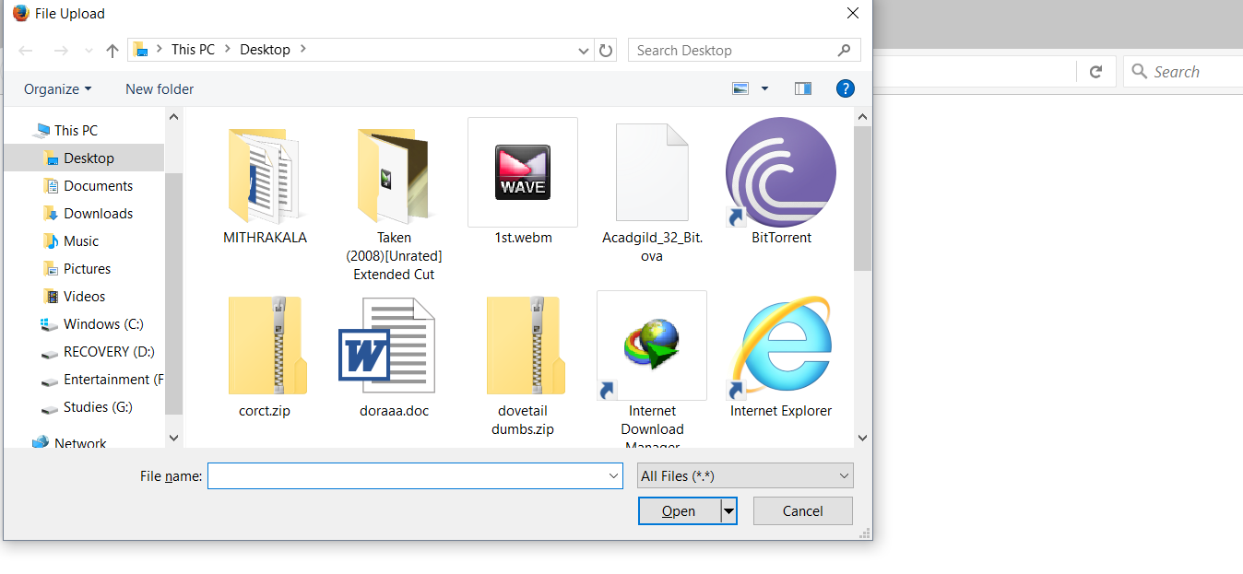

Slide 29
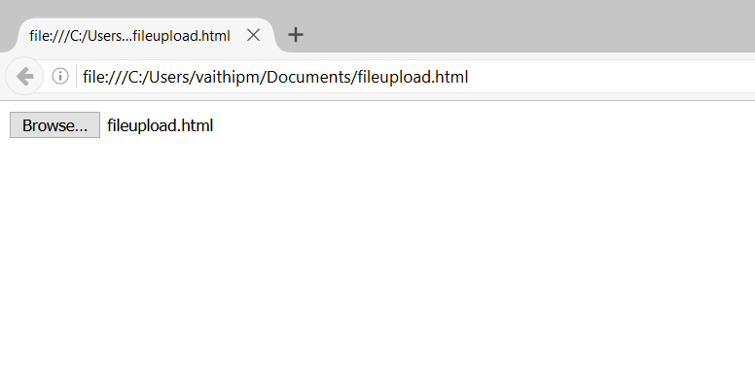

Slide 30
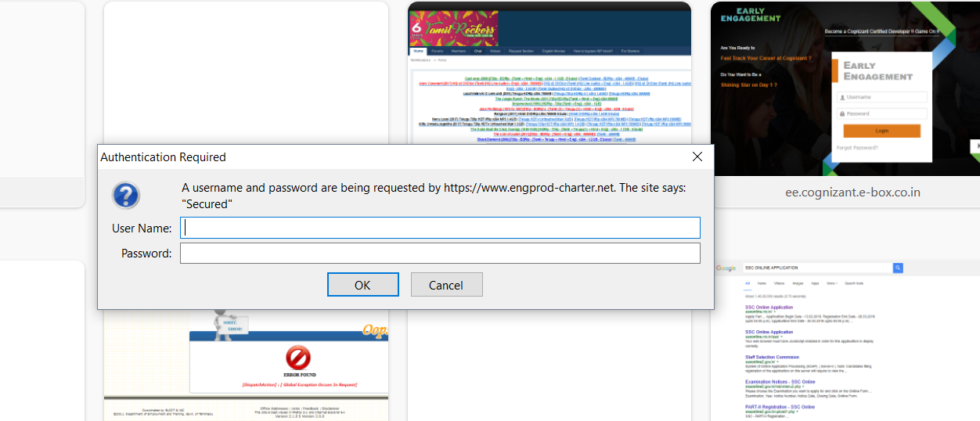
AUTHENTICATION WINDOW

Slide 31
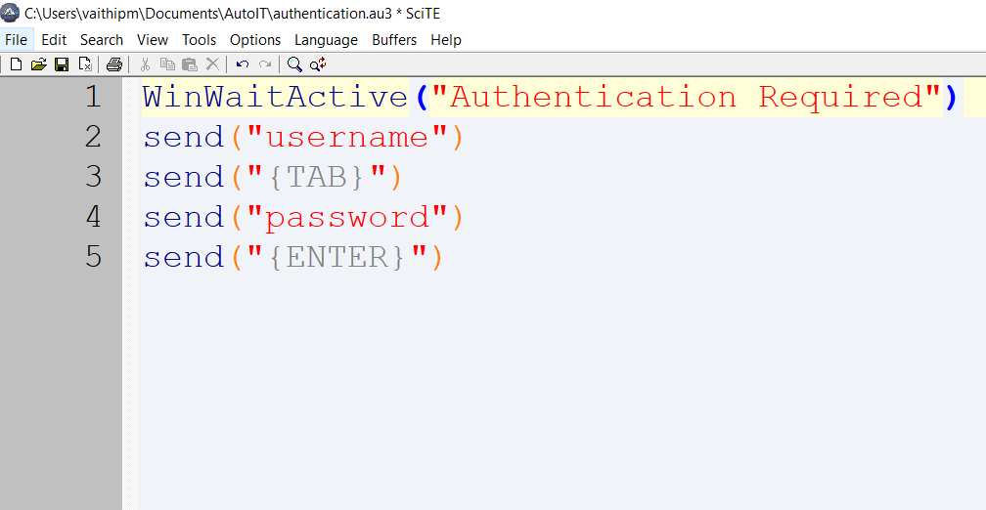
CREATING SCRIPT

Slide 32
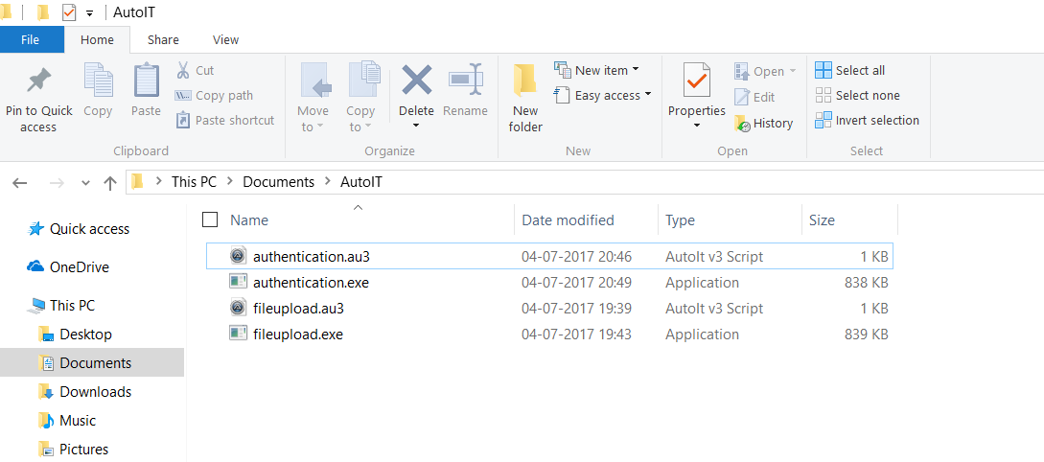
COMPILATION

Slide 33
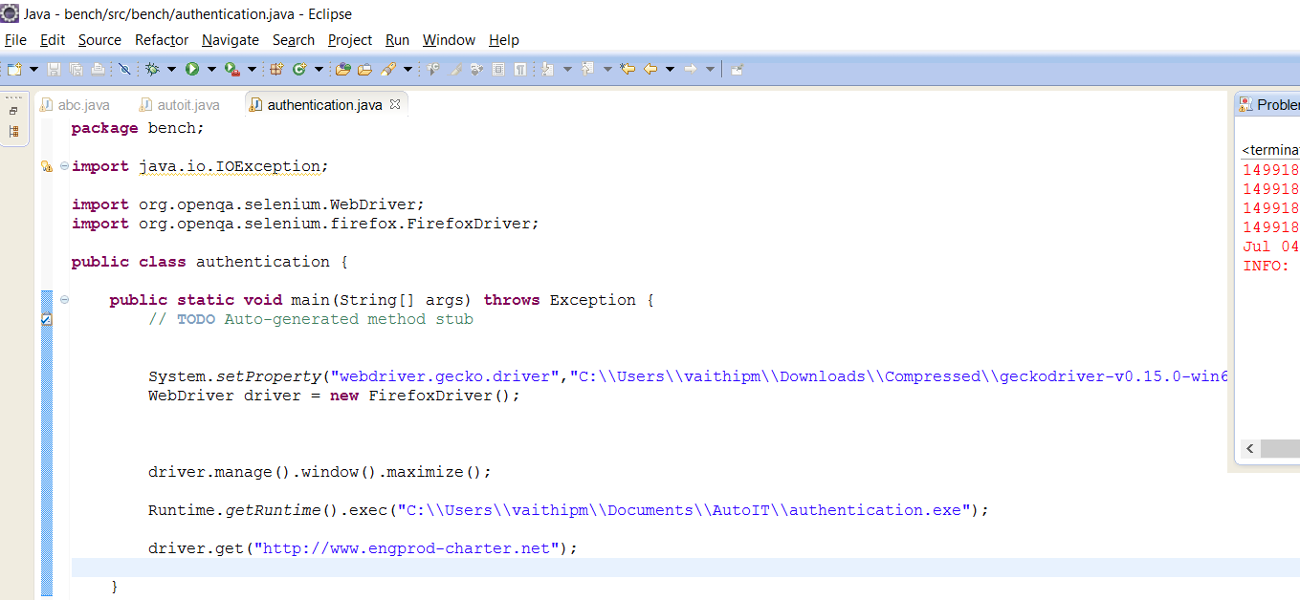

Slide 34
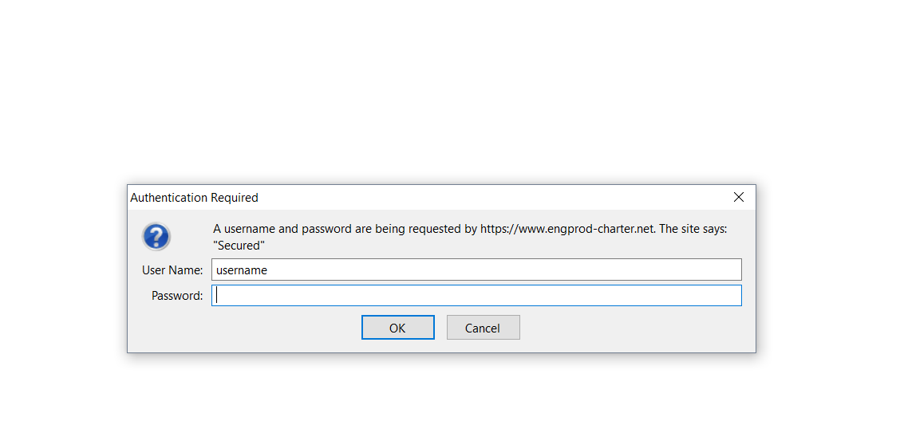

Slide 35
DRAG AND DROP
We have predefined method called dragAndDrop(source, destination) which is a method of Actions class.
Syntax
Actions act = new Actions(driver)
dragAndDrop(source,destination).build().perform()

Slide 36


